Slide 1

Language Model Beats Diffusion – Tokenizer is Key to Visual Generation
Google | Carnegie Mellon University
ICLR 2024
*Slides borrowed from Lijun Yu’s Talk

Slide 2
Motivation
LMs (e.g., GPT-4) have dominated generative tasks in language
LMs can also generate images and videos, e.g., DALL·E, MaskGIT
But they do not perform as well as diffusion models, e.g., LDM
A significant gap exists on the gold standard ImageNet benchmark (FID 3.4 vs. 1.8)
Why do language models lag behind diffusion models in visual generation?
Here LMs refer to transformer models that learn discrete token sequences

Slide 3
Background: LMs in Visual Generation
Pixels are mapped into a sequence of discrete tokens by a visual tokenizer, then processed by an LM transformer as if they are lexical tokens.
Tokenizer remains the key bottleneck that controls sequence length and generation quality.
 |  | Tokenizer | LM Type
Image | ImageGPT | Color clustering | AR-LM & MLM
 | DALL·E | dVAE | AR-LM
 | Taming transformer | VQGAN | AR-LM
 | Parti | ViT-VQGAN | AR-LM
 | MaskGIT & Muse | VQGAN | MLM
Video | Phenaki | CViViT VQGAN | MLM
 | MAGVIT | 3D VQGAN | MLM

Slide 4
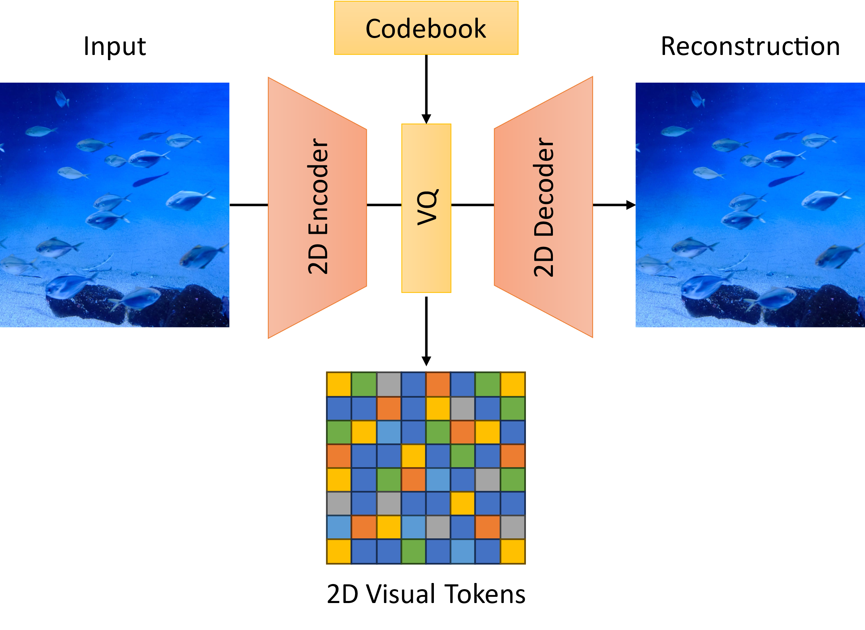
Preliminary: Image Tokenization
Usually designed around the VQ-VAE framework
Autoencoder with a discrete bottleneck
Vector quantization with a learned codebook
Spatial down sampling with CNN or ViT encoders
Variants with different setups
DALL·E dVAE uses ELB with gumble-softmax
VQGAN adds perceptual and GAN losses
ViT-VQGAN uses StyleGAN discriminator

Slide 5
Video Tokenization
Naively: frame-by-frame tokenization
Suffer from consistency issues, esp. for VQGAN
Long redundant token sequence is a burden
MAGVIT 3D VQGAN – prior best video-native tokenizer
Inflated 3D CNN architectures for better motion and consistency
Spatial-temporal down sampling to reduce redundancy
Losses: L2, perceptual, GAN, commitment, codebook, entropy, LeCAM

Slide 6
Issues with MAGVIT Tokenizer
AR-LM and MLM do not scale well beyond 2B parameters.
Performance mainly bounded by the tokenizer
Vocabulary is limited around 1-8k, compared to ~200k used in LLMs
Larger vocabulary hurts generation performance
Only supports 16-frame clips, not images or longer videos
Convolution padding results in strong implicit temporal encoding
Hinders joint training with large-scale image data and long video generation

Slide 7
Introducing MAGVIT-v2 Tokenizer
Lookup-free quantizer enables scalable vocabulary that helps generation
Temporally causal 3D CNN jointly supports images and videos of variable length
A collection of enhancements for visual quality
State-of-the-art image and video generation on standard benchmarks.
Better video compression than HEVC and VVC
Stronger video understanding than MAGVIT

Slide 8
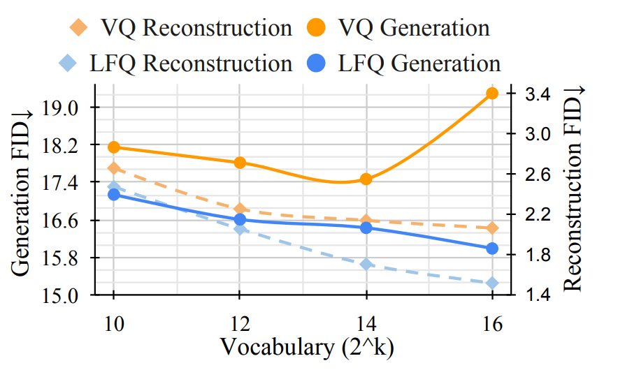
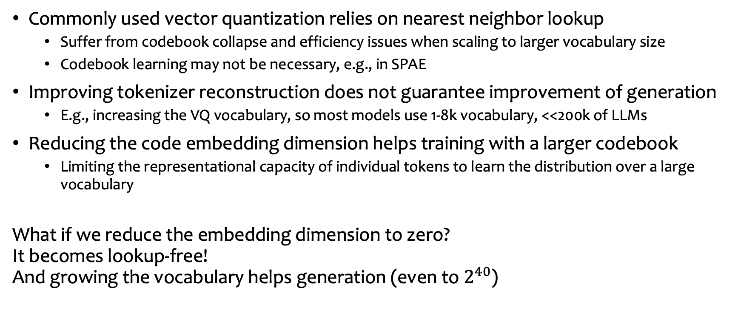
Lookup-Free Quantization
Commonly used vector quantization relies on nearest neighbor lookup
Suffer from codebook collapse and efficiency issues when scaling to larger vocabulary size
Codebook learning may not be necessary, e.g., in SPAE
Improving tokenizer reconstruction does not guarantee improvement of generation
E.g., increasing the VQ vocabulary, so most models use 1-8k vocabulary, <<200k of LLMs
Reducing the code embedding dimension helps training with a larger codebook
Limiting the representational capacity of individual tokens to learn the distribution over a large vocabulary
What if we reduce the embedding dimension to zero? It becomes lookup-free! And growing the vocabulary helps generation (even to $2^{40}$)

Slide 9
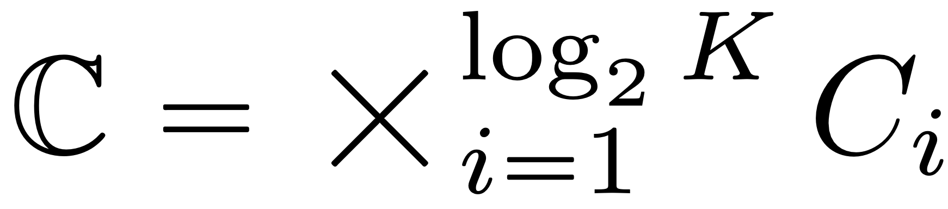
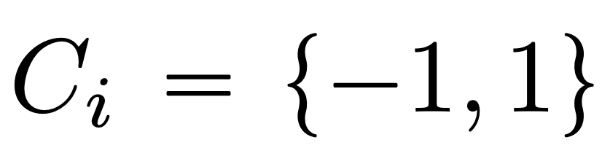
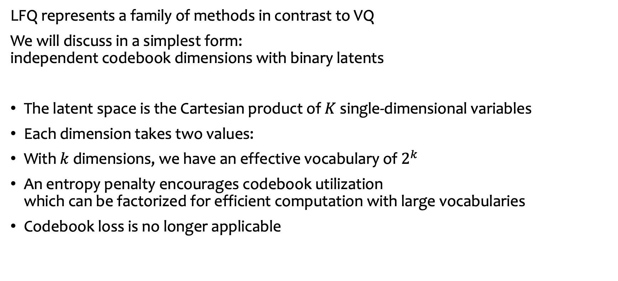
Lookup-Free Quantization
LFQ represents a family of methods in contrast to VQ
We will discuss in a simplest form: independent codebook dimensions with binary latents
The latent space is the Cartesian product of $K$ single-dimensional variables
Each dimension takes two values:
With $k$ dimensions, we have an effective vocabulary of $2^{k}$
An entropy penalty encourages codebook utilization which can be factorized for efficient computation with large vocabularies
Codebook loss is no longer applicable

Slide 10
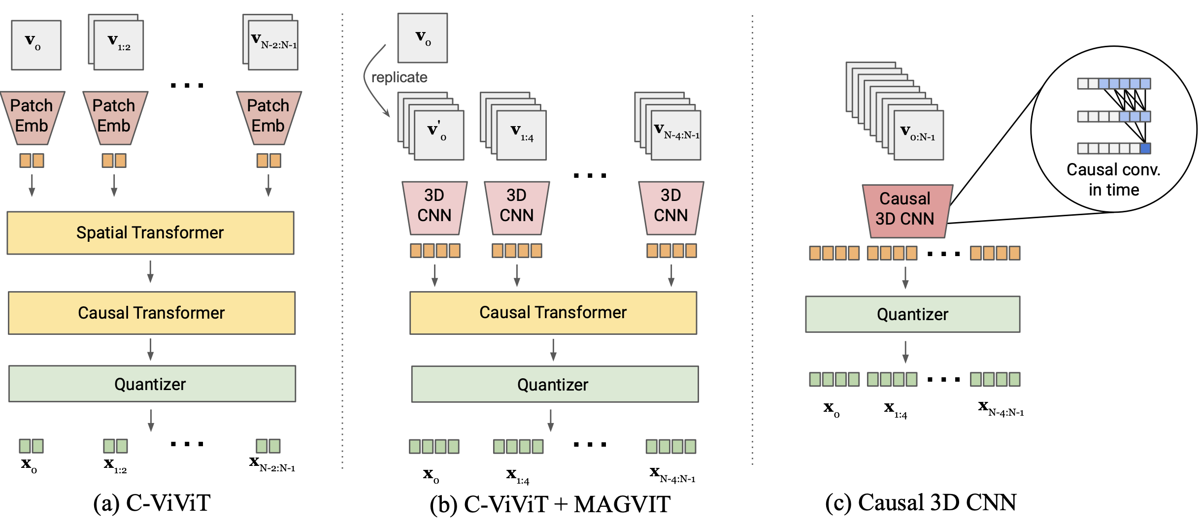
Joint Image-Video Tokenization
Utilizing large-scale labeled image data has been shown beneficial for video models
E.g., make-a-video, phenaki, etc.
Native 3D CNNs in MAGVIT face challenges to tokenize single images due to temporal receptive field
Existing solution: C-ViViT from phenaki ➡️
Hard to generalize to different spatial resolutions
Worse visual quality
Worse spatial causality of tokens

Slide 11
Joint Image-Video Tokenization
Exploring two new designs:
Combining C-ViViT and MAGVIT
3D CNNs replace the spatial transformer and process 4-frame blocks.
Temporally causal 3D CNN, via custom convolution padding and upsampling
The first frame remains independent.
Allowing for videos of variable length.

Slide 12
Joint Image-Video Tokenization
Comparing joint/causal tokenization architectures on UCF-101.
FID is calculated on the first frame.
 | # Params | FID↓ | FVD↓
MAGVIT | 39M | n/a | 107.15
C-ViViT | 90M | 28.02 | 437.54
C-ViViT + MAGVIT | 67M | 13.52 | 316.70
MAGVITv2 | 58M | 7.06 | 96.33

Slide 13

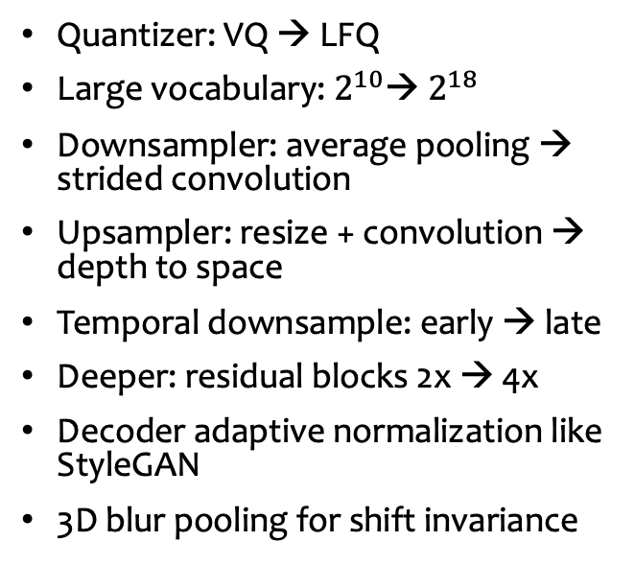
Architecture Ablations
Quantizer: VQ → LFQ
Large vocabulary: $2^{10}$→ $2^{18}$
Downsampler: average pooling → strided convolution
Upsampler: resize + convolution → depth to space
Temporal downsample: early → late
Deeper: residual blocks 2x → 4x
Decoder adaptive normalization like StyleGAN
3D blur pooling for shift invariance

Slide 14
Image Reconstruction
VQGAN
(ImageNet)
MAGVIT-v2
(ImageNet)
MAGVIT-v2
(Web Images)
Original
VQGAN fails to reconstruct facial details
MAGVIT-v2 does a much better job when trained on the same dataset
Much larger vocabulary
More powerful decoder
And it further scales to larger data

Slide 15
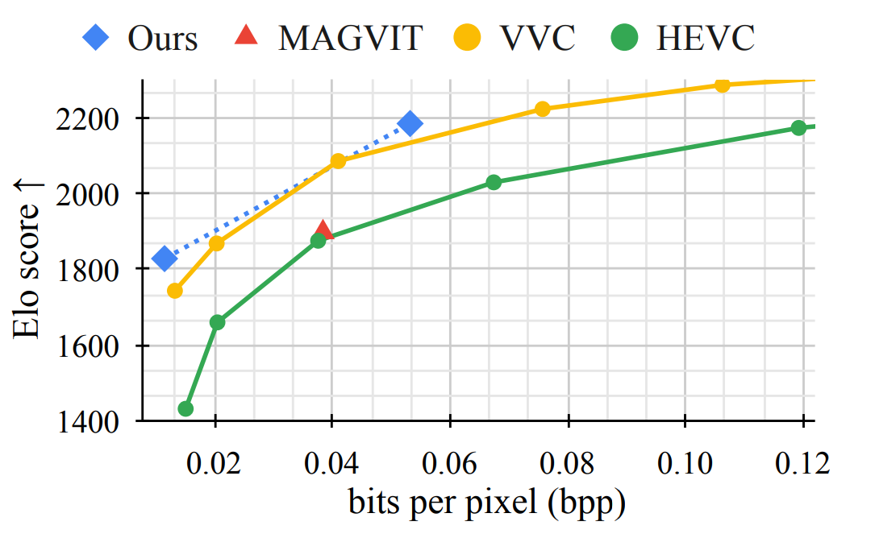

Video Compression
MAGVIT-v2 is preferred over MAGVIT, HEVC (H.265), and VVC (H.266) in subjective rater study.

Slide 16
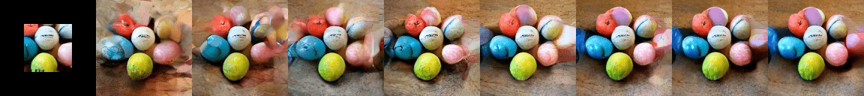
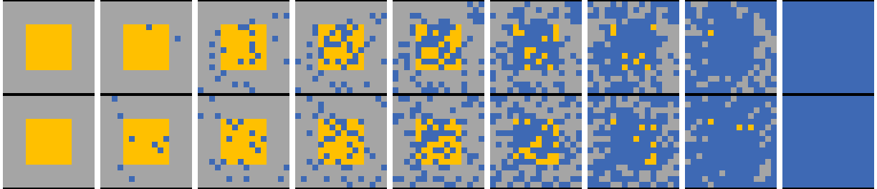
Masked Video Synthesis
Input video
Here we decode intermediate states for visualization, which does not happen in standard sampling.
Generated videos
Sampling progress
Bidirectional Transformer
Masked tokens at each step: Mask Condition Prediction
Initial state includes the condition
Keep some generated tokens at each step
All output tokens are predicted by the model, including condition

Slide 17
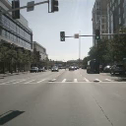
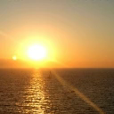



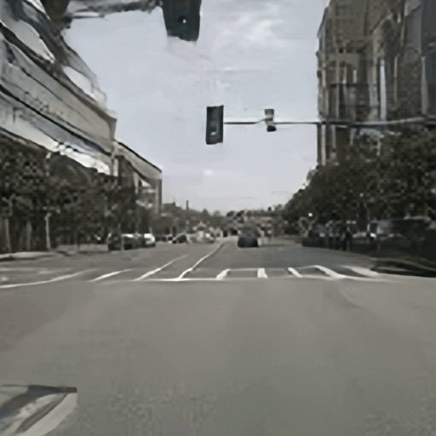


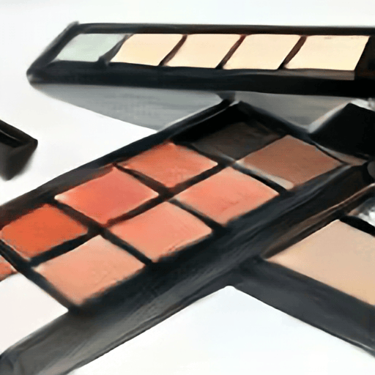
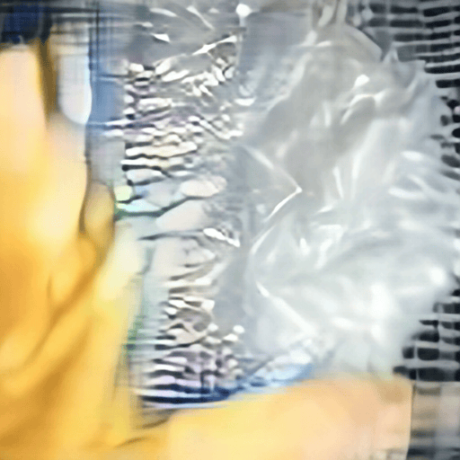
MAGVIT: Masked Generative Video Transformer
The first multi-task masked transformer for video generation, with state-of-the-art generation quality and efficiency.
Squeezing something
Frame
Prediction
Frame
Interpolation
Out painting
Class-conditional generation
Inpainting

Slide 18

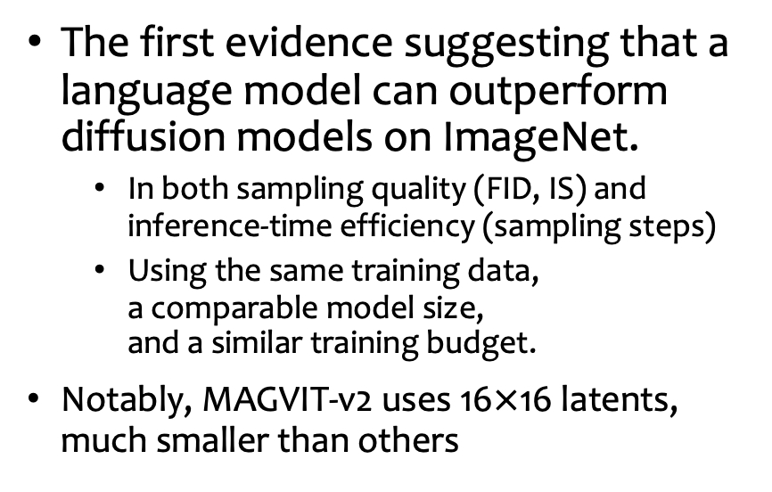
Image Generation
Class-conditional generation on ImageNet 512$×$512
Type | Method | FID↓ | Guided FID↓ | # Params | # Steps | Latent
Diff. + VAE* | DiT-XL/2 | 12.03 | 3.04 | 675M | 250 | 64²
Diffusion | RIN | 3.95 |  | 320M | 1000
Diffusion | VDM++ | 2.99 | 2.65 | 2B | 512
MLM + VQ | MaskGIT | 7.32 |  | 227M | 12 | 32²
MLM + VQ | DPC | 3.62 |  | 619M | 72 | 32²
MLM + LFQ | MAGVIT-v2 | 4.61 |  | 307M | 12 | 16²
 |  | 3.07 | 1.91 |  | 64
The first evidence suggesting that a language model can outperform diffusion models on ImageNet.
In both sampling quality (FID, IS) and inference-time efficiency (sampling steps)
Using the same training data, a comparable model size, and a similar training budget.
Notably, MAGVIT-v2 uses 16$×$16 latents, much smaller than others

Slide 19

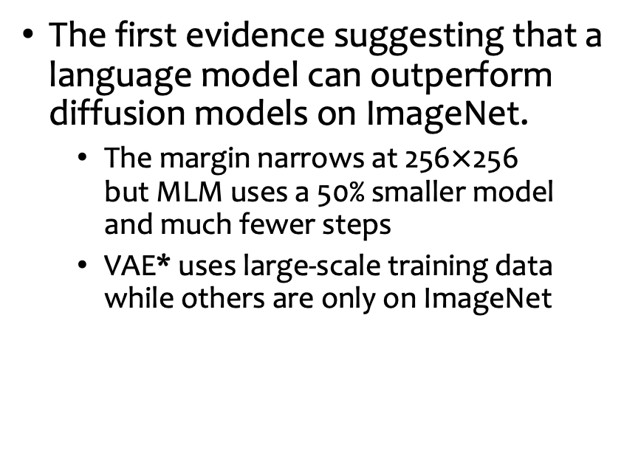
Image Generation
Class-conditional generation on ImageNet 256$×$256
Type | Method | FID↓ | Guided FID↓ | # Params | # Steps
Diffusion + VAE* | MDT | 6.23 | 1.79 | 676M | 250
Diffusion | RIN | 3.42 |  | 410M | 1000
Diffusion | VDM++ | 2.40 | 2.12 | 2B | 512
MLM + VQ | Contextual RQ | 3.41 |  | 1.4B | 72
MLM + VQ | DPC | 4.45 |  | 454M | 180
MLM + LFQ | MAGVIT-v2 | 3.65 | 1.78 | 307M | 64
The first evidence suggesting that a language model can outperform diffusion models on ImageNet.
The margin narrows at 256$×$256 but MLM uses a 50% smaller model and much fewer steps
VAE* uses large-scale training data while others are only on ImageNet

Slide 20
Video Generation
Video Generation: Frame prediction on Kinetics-600 and class-conditional generation on UCF-101
Type | Method | K600 FVD↓ | UCF FVD↓ | # Params | # Steps
Diffusion | VDM | 16.2±0.3 |  | 1.1B | 256
Diffusion | RIN | 10.8 |  | 411M | 1000
MLM + VQ | MAGVIT | 9.9±0.3 | 76±2 | 306M | 12
MLM + LFQ | MAGVIT-v2 | 5.2±0.2 |  | 307M | 12
 |  | 4.3±0.1 | 58±3 |  | 24
MAGVIT-v2 surpasses all prior arts
MAGVIT-v2 significantly outperforms MAGVIT
Using the same MLM backbone and decoding procedure
Highlighting the importance of a good tokenizer

Slide 21
Video Generation
MAGVIT-v2 Tokenizer
AR-LM
MLM
LDM
MAGVIT-v2 enables remarkable video generation quality with transformers using various objectives
MLM – shown so far
AR-LM – VideoPoet
LDM – W.A.L.T

Slide 22

Thank you!

